Slide 1
LGBTQ2S+ Language
Notes:
Good afternoon,
This panel is to explore the topic of equity, both from the realm of staff supporting elected officials and from the perspective of colleagues employed by an Association. It will introduce participants to developments in LGBTQ2S+ verbiage while exploring how the language used within a workplace can affect equity. The panel will conclude with a candid discussion on the benefits and challenges associated with creating a diverse and equitable workplace, offering time for questions.
Our learning objective:
Gain knowledge regarding the difference between “sex”, “gender” and “sexuality”.
Gain knowledge regarding common LGBTQ2S+ verbiage.
Gain tools on how to navigate unfamiliar linguistic interactions (e.g. asking someone’s pronouns).
But before we dive into that, I wanted to introduce myself to the group. My name is Derrick Antson, I use He/Him pronouns, and I am the Labour Relations Officer with the Mount Royal Faculty Association. I have been a volunteer and activist within the queer community for a number of years, helping to organize pride celebrations, speaking at marches, and organizing protests. I am also nervous about being here today. Despite my involvement within the LGBTQ+ community, I am suffering from imposter syndrome. And I am seeing a lot of the worries within myself, right now, that I have seen within my colleagues and comrades when they interact the LGBTQ+ community, or any equity seeking group. We don’t want to make a mistake or offend anyone, and are unsure if our knowledge is up-to-date. And this is what brought me to suggesting this panel. To recognize that I, like everyone here today, is still learning, and that there are a lot of different word that exist and have existed, and that its okay not to know all the things.
So in addition to the 3 formal learning objectives, I am offering a fourth outcome; a pathway forward as we learn together; an understanding that topics of this nature can cause anxiety and that no one is perfect. Honest mistakes happen and that’s why we engage in professional development conferences, to learn what we don’t know.

Slide 2
Context of Language
Land acknowledgement
University of Prince Edward Island (Charlottetown)
We would like to begin by acknowledging that the land on which we gather is the traditional and unceded territory of the Abegweit Mi’kmaq First Nation.
Notes:
Before we get into the content, I want to take a moment to quickly look at why context is important, and doing so through a land acknowledgement.
University of Prince Edward Island (Charlottetown) offers, “We would like to begin by acknowledging that the land on which we gather is the traditional and unceded territory of the Abegweit Mi’kmaq First Nation.”
Prior to the Truth and Reconciliation Commission, the Indigenous history of our land was, by-in-large, forgotten. Our ancestors (colonizers) came to this land, they developed a history of the anglophones and francophones, and they participated in acts that were designed to erase the Indigenous culture (e.g. residential schools). The power of self-determination regarding how to use traditional words/language was removed.
Through the truth & reconciliation process these connections are being rebuilt and promoted. And words and language that was once ostracized, is now being given a place in the dominate culture.
And it is this connection that leads me into a discussion of LGBTQ2S+ language; a reclaiming of language and words by equity seeking groups and a recognition that words have power.
Sources
1. Guide to Acknowledging First Peoples & Traditional Territory: https://www.caut.ca/content/guide-acknowledging-first-peoples-traditional-territory

Slide 3
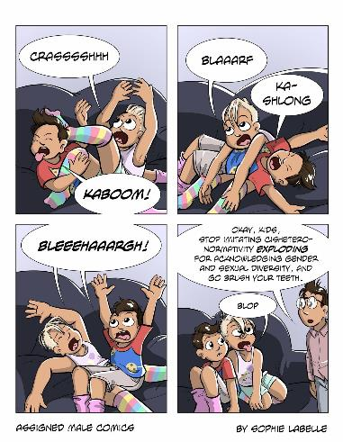
Sources & Information
Sources
All citations are stored within the Notes of the PowerPoint. And the PowerPoint will be shared.
Notes:
Regarding Sources:
All citations are stored within the Notes of the PowerPoint. And the PowerPoint will be shared in the post conference material. Ask Lori on how to access this information.
I have also included Additional Links to provide more information for your viewing.
The sources are not academic/peer-reviewed journals because i) those type of references are not super prevalent. The LGBTQ2S+ community is still (quickly) developing and there is a historical legacy of remaining hidden. Even within the last 5 years there have been a number of developments. And ii) journal entries are not that fun to read.
Comics:
I have included a variety of comics and images throughout the PowerPoint. The one on this screen is from Sophie Labelle, a Canadian cartoonist that illustrates topics related to queer and trans life.
If you need me to read any of the comics aloud, please let me know. I recognize that the font may be small in some.
Sources
2. Comic: Assigned Make Comic by Sophie Labelle

Slide 4
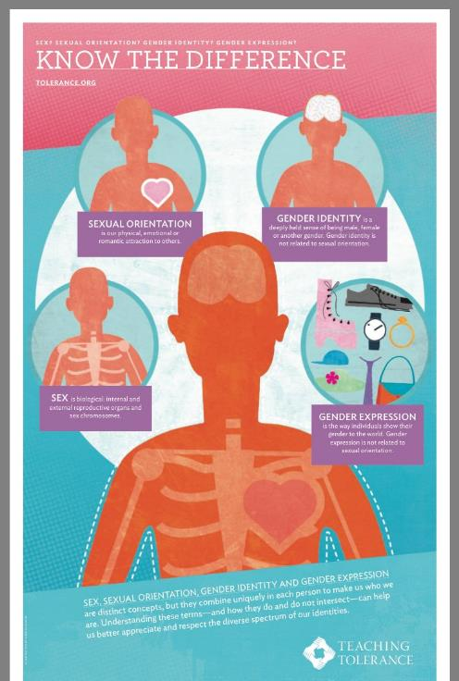
Sex, Sexuality, & Gender
Sex (Anatomy)
Sexuality (Attraction)
Gender
Sexuality ≠ Gender ≠ Sex.
Notes:
Sex (Anatomy)
Sex is biological: internal and external reproductive organs and sex chromosomes.
Refers to a person’s anatomy, physical attributes such as external sex organs, sex chromosomes and internal reproductive structures.³
Sexuality (Attraction or Sexual Orientation)
Sexual Orientation is our physical, emotional or romantic attraction to others.
Refers to our physical, emotional and/or romantic attractions to others. ³
Gender
Gender Identity
Gender Identity is a deeply held sense of being male, female or another gender. Gender identity is not related to sexual orientation.
Refers to an individual’s deeply held sense of being male, female, or another gender. This is separate from biological sex. ³
Gender Expression
Gender Expression is the way individuals show their gender to the world. Gender expression is not related to sexual orientation.
Refers to the way we show our gender to the world around us.³
Additional Links
True Colors United – Sexual Orientation, Gender Identity, and Gender Expression: https://www.youtube.com/watch?v=Vlx9iZ9g_9I
Sources
3. Sex? Sexual Orientation? Gender Identity? Gender Expression?: https://www.tolerance.org/magazine/summer-2015/sex-sexual-orientation-gender-identity-gender-expression
4. Poster: Know the Difference: https://www.tolerance.org/topics/gender-sexual-identity

Slide 5
Sex, Sexuality, & Gender
Sex is not binary.
Gender is not binary.
Notes:
Sex is not binary. Gender is not binary.
“This diversity can be better understood by using spectrum-based models. Spectra make room for anyone whose experiences do not narrowly fit into binary choices such as man/woman, feminine/masculine or straight/gay.”²
Additional Links
Transgender Basics – Gender Identity Project (GIP): https://www.youtube.com/watch?v=UXI9w0PbBXY&list=PL9B3630951F9F48EF&index=2&t=0s
Sources
3. Sex? Sexual Orientation? Gender Identity? Gender Expression?: https://www.tolerance.org/magazine/summer-2015/sex-sexual-orientation-gender-identity-gender-expression
5. Comic: Trans Student Educational Resources: http://www.transstudent.org/gender

Slide 6
Cisgender & Transgender
Notes:
Cisgender is a word that is developed from the Latin prefix “cis-”, meaning “on the side of…” So unpacking this word, a cisgender man has a gender identity on the side of the sex he was assigned at birth. “Cis” or “cisgender” is not a slug or insult.
Transgender, develops out of the Latin prefix “trans-”, meaning “on the opposite side of…” So, a transgender women’s gender identity is on the opposite side of the sex she was assigned at birth. The term transgender is not indicative of gender expression, sexual orientation, hormonal makeup, physical anatomy, or how one is perceived in daily life.
By using cisgender to describe the gender of those who are not trans we break down structures that posit cis individuals as “normal”. When neither is more “normal” than the other.
Sources
6. Comic: http://rebloggy.com/post/popular-lgbtq-transgender-trans-gender-identity-gender-queer-genderqueer-infogr/35780906575

Slide 7
Pronouns
Notes:
A pronoun is a word that can function by itself as a noun phrase and that refers either to the participants in the discourse (e.g., I, you ) or to someone or something mentioned elsewhere in the discourse (e.g., she, it, this).
There are a variety of pronouns. I shared earlier that mine are He/Him. Others that you might encounter are She/Her, They/Them, or Ze/Zir.
Some pronouns are gendered (He/Him & She/Her), while others are gender neutral (They/Them & Ze/Zir).
It is proper English to use They/Them as a singular pronoun for a person. It has been used since the time of Shakespeare.
Another gender neutral title that you might encounter is “Mx” as equivalent to “Mr” or “Ms”.
Additional Links:
It’s OK To Use “They” To Describe One Person: Here’s Why: https://www.dictionary.com/e/they-is-a-singular-pronoun/?fbclid=IwAR3xOicrL5RWv-5G9oQSSv_v95jxGjQ8f_zsGcSTGjGi5rghBcjDg-iLBqg
Sources
7. Trans Student Education Resources - Gender Pronouns: http://www.transstudent.org/pronouns101/

Slide 8
Pronouns
How Do You Ask?
https://www.youtube.com/watch?v=r-al4liNLBU&feature=youtu.be

Slide 9
Queer
Current Usage
“Being queer is not about a right to privacy; it is about the freedom to be public, to just be who we are.”
-Queers Read This, 1990
Vs.
Historical Usage
“Strange, odd, peculiar, eccentric. Also: of questionable character; suspicious, dubious.”
- Oxford English Dictionary
Notes:
Historical Usage vs. Current Usage
Queer was first linked to the LGBTQ2s+ community as a derogatory terms. A lot of older individuals will react negatively to this term as a result.
Queer is a modern usage of the word, it has been reclaimed and is used as an umbrella term for anyone who is a member of the LGBTQ2S+ community.
It is also worth noting that many trans people use Queer as an identity (around 21%) rather than any another sexual orientation.
(https://alexkapitan.files.wordpress.com/2017/08/trans-style-guide_rev-july-2018.pdf)
It can operate as an umbrella term for people outside of the heterosexual norm, or for people who challenge the LGBT (Lesbian, Gay, Bisexual, Trans) ‘mainstream’. It can also be a way of challenging norms around gender and sexuality through different ways of thinking or acting.
Queer is a complex word with many different definitions.
Additional Links
Inqueery: History of the Word Queer https://www.them.us/story/inqueery-history-of-the-word-queer
Lea DeLaria (Orange is the New Black) Discussion of the Word Queer https://www.facebook.com/Channel4News/videos/536027033531634/
Sources
8. Comic: Queer A Graphic History by Meg-John Barker (Author) Julia Scheele (Illustrator), page 7.

Slide 10
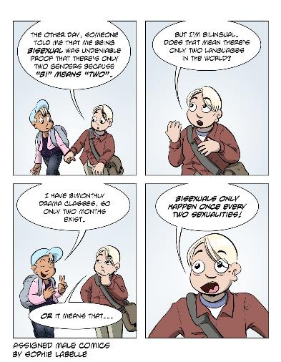
Lesbian / Gay / Bisexual
Lesbian – a woman that is solely attracted to other women, be it sexually or romantically.⁹
Gay – a word used to describe individuals who experience attraction specifically to individuals of their own gender. Usually denoting a self-identified man who is attracted to other self-identified men.⁹
Bisexual – the state of being attracted to individuals of your own gender and other genders.⁹
Notes:
These three words describe someone’s Sexuality. Whether it be liking someone of the same gender or someone of other genders.
In today’s day-and-age, these have become common place terms. In the interest of time, does anyone need me to highlight anything specific about the terms Lesbian, Gay, Bisexuality?
Then before we move on, I wanted to highlight a couple things
Bisexuality has a few misnomers. 1) Bisexuality is real and valid, 2) a person is still bisexual regardless of the gender of their partner, 3) it is not a transition “phase,” and is to be accept no different then any other sexuality.
Historically, the term Gay has been used as an umbrella term to refer to anyone that fits into the LGBTQ2S+ community. It wasn’t precise in its description, obscured the uniqueness of many people that were within the LGBTQ2S+ community, and often offered an assumed that an individual held a default identity of male, cisgender, white, etc. A good example of this change is GAY PRIDE vs. PRIDE. When Pride celebrations started they were marked as “gay pride,” but with the inclusion of popular politics, media, corporate donation, increased marginalization of non-white/male/cisgender member of the LGBTQ2S+ community. You saw the growth of Dyke and Trans Marches, as a way to reclaim space. It came with it a rejection of the term “gay” as an umbrella term and a term that just related to no longer saw themselves reflected in the celebration.
Additional Links
Inqueery: History of the Word Butch: https://www.them.us/story/inqueery-butch
Inqueery: History of the Word Femme: https://www.them.us/story/inqueery-femme
I Came Out Late in Life. And That’s Okay.: https://thenib.com/i-came-out-late-and-that-s-okay
Sources
9. ULSU Pride Centre: http://www.ulsupride.ca/glossary.html
10. Comic: Assigned Make Comic by Sophie Labelle

Slide 11
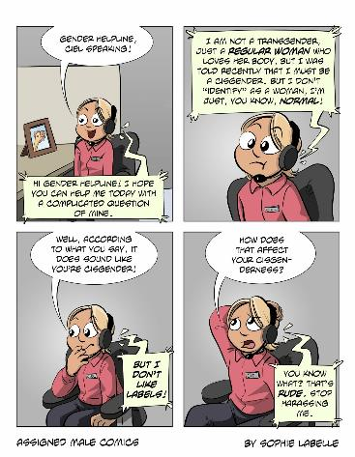
Transgender
An umbrella term for people whose gender identity differs from the sex they were assigned at birth.¹¹
Related Words:
Transsexual
Transvestite
Cross-dresser
Drag Queen
Notes:
The word “transgender” has gone through a lot of developments over the years, both in meaning and in how trans individuals were labeled. (Reminder: Transgender, develops out of the Latin prefix “trans-”, meaning “on the opposite side of…”) I have included some of these words within the Related Words section of the slide; they include Transsexual, Transvestite, Cross-dresser, and Drag Queen.
In today’s vallecular, each of these words has taken on its own meaning. Within a professional setting the term I would suggest using is transgender or trans; unless otherwise directed by the individual.
Myth: A myth that exists is that all individuals who are transgender must and/or wants to transition to the other gender.
Although this may be true for some, it is not true for all. A person doesn’t need to change their sex/anatomy to align it with their gender identity to be trans. For some, its empowering to fit within a binary box, for others its not.
Transgender does not have an “ed” at the end.
Trans-trender – A derogatory terms that implies that a transgender individual’s identity has been embodies because it “trendy”
So far, we have focused our discussion in a loose binary, that is to say, around the male/female poles of sex and gender. But, remembering that Transgender is an umbrella term from people whose gender identity differs from the sex they were assigned at birth, it is important to look at the spectrum and the variety of identities that are between these to two poles. Transgender develops into an umbrella term being used to refer to all of these identities, while still allowing for more precise terms to come through.
Additional Links
What Is It Like to Be a Trans Woman? Eisha Love Answers Your Questions: https://www.them.us/story/eisha-love-answers-twitter-questions
InQueery: Trixie Mattel Breaks Down the History of “Drag”: https://www.them.us/story/inqueery-drag
InQueery: What Does the Word “Transgender” Mean?: https://www.them.us/story/inqueery-transgender
Update to Transgender Style Guide: Avoiding Invalidating Language Traps: https://radicalcopyeditor.com/2018/07/13/update-to-transgender-style-guide-avoiding-invalidating-language-traps/
How to Talk (and Listen) to Transgender People | TED Talk: https://www.ftmmagazine.com/how-to-talk-and-listen-to-transgender-people-ted-talk/
What Trying to Access Health Care is Like for Transgender and Gender-Nonconforming People: https://www.teenvogue.com/story/going-to-doctor-when-transgender-and-gender-nonconforming
A Startling Look at How Cops Mistreat Trans People: https://www.vice.com/en_ca/article/wjvnw9/police-department-policies-toward-transgender-people
Nickelodeon Actor Reveals He Transitioned Before Coming to Hollywood: https://www.pride.com/comingout/2019/5/26/nickelodeon-actor-reveals-he-transitioned-coming-hollywood
Sources
11. Trans Student Educational Resources: http://www.transstudent.org/definitions/
12. Comic: Assigned Make Comic by Sophie Labelle

Slide 12
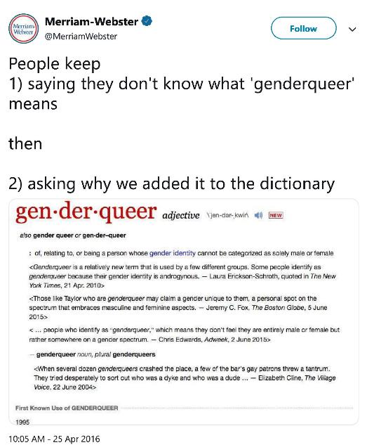
Greygender
Genderqueer
Non-binary
Demigender
Gender Non-conforming
Agender
Notes:
Transgender is an umbrella term that encompasses a wide variety of other terms that are used to define and label people’s sexual and gender identities. Some examples that you might encounter are: Demisexual, Greyromantic, Intersex, Gender Non-conforming, Agender, Non-binary, and Genderqueer, just to name a few.
I wanted to take a moment to highlight two that I have been encountering on an increasing basis.
Genderqueer & Non-Binary
Both can be used as an umbrella term to describe someone’s identity or an as a specific identity.
Both draw attention that the individual departs from the binary of male/female.
Within the notes of the PowerPoint I’ve highlight links to act as a soft introduction to the terms. But I wanted to highlight these two terms because I have seen an increase use of them, and they pose a unique challenge for standard ‘Male v Female’ dichotomy.
Additional Links
InQueery: What Does It Mean to Be Intersex?: https://www.them.us/story/inqueery-intersex
BBC News Africa – Babalwa is Intersex: https://www.facebook.com/285361880228/posts/10157443319195229?s=731060561&v=e&sfns=mo
InQueery: The History of the Word “Genderqueer” As We Know It: https://www.them.us/story/inqueery-genderqueer
How to Be Respectful and Supportive to Non-Binary People: https://www.ftmmagazine.com/non-binary/
What Everyone Should Know About Genderqueer and Non-binary: https://www.psychologytoday.com/ca/blog/sex-sexuality-and-romance/201807/what-everyone-should-know-about-genderqueer-and-non-binary
Boobs Aren’t Binary: https://thenib.com/boobs-aren-t-binary?t=recent
Here’s What It Means When You Don’t Identify as a Girl or a Boy: https://www.teenvogue.com/story/what-is-non-binary-gender
Sources
17. Merriam-Webster, Twitter, April 25, 2016. https://twitter.com/merriamwebster/status/724645568014868480?lang=en

Slide 13
Asexual
An individual that does not experience sexual attraction.¹³
Related (but different) terms:
Demisexual
Greysexual
Demiromantic
Greyromantic
Aromantic
Notes:
Helpful to think of Asexuality as the other side of the coin from homosexuality/heterosexuality. Homosexuality & heterosexuality have some sexual attraction to other people, while asexuality don’t.
Ace Spectrum -- a continuum that contains all ace identities, including asexual, greysexual, demisexual, aromantic, greyromantic and demiromantic.
Asexual -- an individual that does not experience sexual attraction.
Demisexual -- an individual that only experiences sexual attraction to a person after forming an emotional bond with said person.
Greysexual -- an individual who experiences sexual attraction very rarely or under very specific circumstances.
Demiromantic -- an individual that only experiences romantic attraction to a person after forming an emotional bond with said person.
Greyromantic -- an individual who experiences romantic attraction very rarely or under very specific circumstances.
Aromantic -- an individual that does not experience romantic attraction.
Homosexual - Of, relating to, or characterized by a tendency to direct sexual desire toward another of the same sex. (Merriam-Webster: https://www.merriam-webster.com/dictionary/homosexual)
Heterosexual - Of, relating to, or characterized by a tendency to direct sexual desire toward the opposite sex. (Merriam-Webster: https://www.merriam-webster.com/dictionary/heterosexual)
Additional Links
Inqueery: History of the Word Agender: https://www.them.us/story/inqueery-agender
MTV Decoded: Asexuality Myths: https://www.facebook.com/MTVDecoded/videos/346632252787094/
5 Affirmations for Asexual People Struggling with Self-Acceptance: https://everydayfeminism.com/2016/08/affirmations-for-asexual-people/?utm_source=facebook&utm_medium=bitch&utm_campaign=swap
Asexuality 101: http://transcendingboundaries.org/pdf/asexuality_brochure.pdf
Trevor Support Centre: Asexuality: https://www.thetrevorproject.org/trvr_support_center/asexual/#sm.0000018hgl4vjrfhttkoy8gmlvvfg
The Asexual Visibility & Education Network: https://www.asexuality.org/?q=family.html
Sources
13. ULSU Pride Centre: http://www.ulsupride.ca/glossary.html
14. Comic: The Asexual Visibility & Education Network: https://www.asexuality.org/en/topic/94606-a-really-well-done-comic-on-asexuality/

Slide 14
Pansexual
is a sexual orientation describing a person who is attracted to all types of people, regardless of sex or gender.¹⁵
Notes:
Pansexual are capable of carrying out sexual, emotional, and romantic relationships with people of all genders. They could be interested in someone who is male, female, transgender, intersex, or genderqueer/gender-fluid. It should be noted that pansexuals are not sexually attracted to everyone; they are simply open towards people of all sexes and gender identities as sexual or romantic partners.
Although similar, pansexuality and bisexuality are two different sexual orientations. Pansexuality refers to the sexual attraction to individuals of any gender.
A key aspect of the pansexual identity is the belief that people do not need to fall within the gender binary, going against the idea that there are only two genders: male and female. Bisexuality, on the other hand, may generally refer to attraction to the two traditional genders: male and female. In a simplistic form Pansexuality is an attraction to All genders vs. Bisexuality is an attraction to my gender & others’ genders.
Additional Links
Pansexuality 101: 5 Keys Facts You Need to Know: https://www.them.us/story/pansexuality-101
Inqueery: History of the Word Pansexual: https://www.them.us/story/inqueery-pansexual
Resource Guide Bisexual and Pansexual: https://lgbtq.arizona.edu/sites/lgbtq.arizona.edu/files/Resource_Guide-Bisexual_and_Pansexual.pdf
What is pansexuality? 4 pan celebs explain in their own words: https://www.glaad.org/blog/what-pansexuality-4-pan-celebs-explain-their-own-words
Schitt’s Creek - I Like the Wine and Not the Label:https://twitter.com/schittscreek/status/878688035789045762?lang=en (an explanation of pansexual orientation using an analogy and humour).
Sources
15. Pansexuality – What is Pansexuality: http://www.soc.ucsb.edu/sexinfo/article/pansexuality
16. Comic: Deviant Art: https://www.deviantart.com/chlove-art/art/Go-Get-a-Roomie-Pansexuality-306776165

Slide 15
Two-Spirit
A translation of the Anishinaabeg (Ojibwa) term niizh manidoowag, referring to individuals who embody both a masculine and feminine spirit.¹⁸
Notes:
Two-Spirit is a translation of an Anishinaabeg (Ojibwa) term referring to individuals who embody both a masculine and feminine spirit. It was developed “[a]t the third annual Intertribal Native American, First Nations, Gay and Lesbian American Conference, held in Winnipeg, Manitoba in 1990.”¹⁸
With that said, there are two things I want to highlight in relation to the term Two-Spirit
1) There is still discussion within the Indigenous community regarding this term. Therefore, this is not a pan-indigenous term. In some cases, it is not adopted because the community maintain language/identities (i.e. colonialism did not whip out) that described these people. It some cases it is not adopted because it is a “foreign” term (Ojibwa), and not one of local culture. In some cases, the individualized implementation of the word differs. Needless-to-say there is still much discussion within the Indigenous community regarding how to define themselves.
2) The term Two-Spirit an attempt to define non-colonial identitie(s) that relate to gender, sex, and sexuality within a colonial context (think back to the Gender Unicorn, Two-Spirit identity does not fit within that model). Non-indigenous individuals have to be mindful when discussing Two-Spirit identity that they bring with them their ancestors‘ history, and a Western understanding of sex/gender/sexuality. (See tweet as an example).
Two things to remember going forward:
1. Two-Spirit identity was a part of indigenous culture on Turtle Island before colonials arrives.
2. Just like the saying All thumbs are fingers, not all fingers are thumbs, it is important to know that not all Indigenous queer people are two-spirit, but all two-spirit individuals are Indigenous.
Additional Links:
Inqueery: Indigenous Identity and the Significance of the Term “Two-Spirit”: https://www.them.us/story/inqueery-two-spirit
CBC: Activist says recognition of 2-spirit identity a crucial part of reconciliation conversation https://www.cbc.ca/news/canada/calgary/two-spirit-harlan-pruden-1.4881603
Gender Variance Around the World Over Time: https://www.teenvogue.com/story/gender-variance-around-the-world
University of Winnipeg Two-Spirit Archives a first in Canada: https://www.cbc.ca/news/canada/manitoba/two-spirit-archives-university-winnipeg-1.5150759?__vfz=medium%3Dsharebar
Sources
18. The Canadian Encyclopedia: https://www.thecanadianencyclopedia.ca/en/article/two-spirit

Slide 16
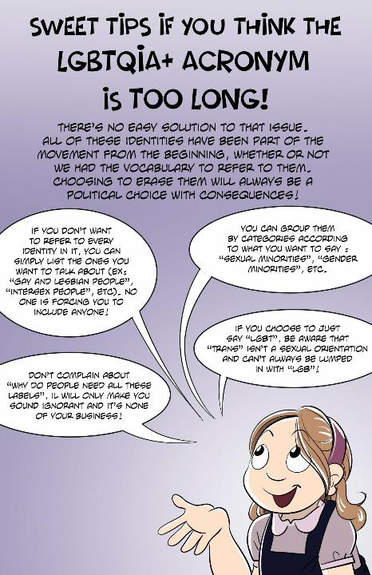
LGBTQ2S+
L – Lesbian
G – Gay
B – Bisexual
T – Transgender
Q – Queer
2S – Two-spirit
+ – A formal, explicit recognition that there are other identities within the community
Variations:
LGBT
LGBTQIA
LGBTQ+
LGBTQ2S+
Notes:
LGBTQ2S+ refers to all of the groups that we have referred to thus far The Lesbian, Gay, Bisexual, Trans, Queer, Two-Spirit plus community.
I wanted to highlight a couple interesting factoids about the acronym “LGBTQ2S+”
L (Lesbian) is commonly listed first in the alphabet. This started as an honorific, to formally recognize and thank the lesbian community for their service during the height of the aids crisis. While most straight personal refused to care for the gay men dying, the lesbian community rallied to care for these men. And for that the “L” is list first.¹⁹
The “+” symbol. This symbol is included to make it explicit that other groups are being referred to, without explicitly saying their letter. Think of it as an ellipsis. It is not needed if everyone who is being referred to is listed. So an alternative to the LGBTQ2S+ community is the LGBTQQ2SIAPA community. Other used forms are an Asterisk (*) or an underscore (_).
Inclusion of Two-Spirit – As was noted earlier there is much discussion within the queer community regarding how and when to include Two-Spirit identity, both explicitly (“2S”) or implicitly (“T”). Each is accompanied by positive and negative implications. Thereby, it is important that your organization consider what the implications could be, consult with the affected community, and make an informed decision moving forward.
Other stylistic ways of representing Two-Spirit identity include allowing the “T” to refer to both Trans and Two-Spirit, or to include a “2” or and “S”.
Sources
19. Outliers: Calgary’s Queer History – Calgary Queer Arts Society. https://www.calgaryqueerartssociety.com/2018-fairy-tales-calgarys-queer-film-festival/2018/5/25/outliers-calgarys-queer-history
20. Comic: Assigned Make Comic by Sophie Labelle

Slide 17
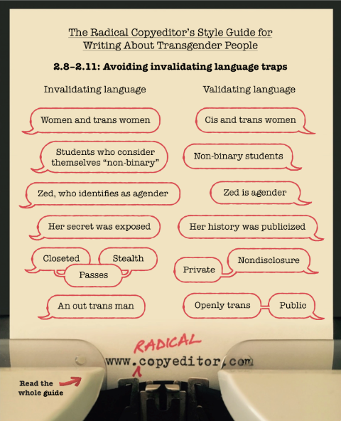
Other Phrases
Alternative lifestyle(s)
Brothers & Sisters
Women and trans women
“Real” women
S/he or He/She
Gay Bar / Gay Rights
“Preferred” Pronouns
Notes:
Alternative lifestyle(s)
- An older phrase, that developed as queer identity was entering into the public eye. Nowadays, its worth noting that there is nothing “alternative” about a queer person’s lifestyle.
Brothers & Sisters
- Common union phrase, but it assumes a gender binary. Try instead “brother, sisters, & non-binary siblings.” or “commands”
Women and trans women (Men and trans men) & “Real” women / men
- Trans women are real women. There is no need to differentiate these groups, unless you are talking about sex (in which case, talk about anatomy and not the person).
S/he or He/She
- Not the best English, its wordy and breaks the flow of a sentence. A gender neutral singular pronoun has been around and used since the time of Shakespeare. Try using “They/them” instead.
Gay Bar / Gay Rights
- An older phrase, that developed when “gay” was still commonly used as an umbrella term for the queer community. These terms are still widely used, but it is worth while taking a moment an examining what the speaker is actually trying to say (is it a bar that is only for gay men or is it a bar that caters the entire queer community?) Often, the language used within popular culture perpetuates hidden biases prevent a group from full participation.
Preferred Pronouns (Preferred Name)
Having cream in coffee is a preference, pronouns are not. Referring to someone’s pronouns as “preferred” signals that it’s a honorific, but not something that must occur.
It is also important, if you ask someone their pronouns/name, you have to take steps to implement that usage.
Additional Links:
It’s OK To Use “They” To Describe One Person: Here’s Why: https://www.dictionary.com/e/they-is-a-singular-pronoun/?fbclid=IwAR3xOicrL5RWv-5G9oQSSv_v95jxGjQ8f_zsGcSTGjGi5rghBcjDg-iLBqg
Source
21. Update to Transgender Style Guide: Avoiding Invalidating Language Traps: https://radicalcopyeditor.com/2018/07/13/update-to-transgender-style-guide-avoiding-invalidating-language-traps/

Slide 18
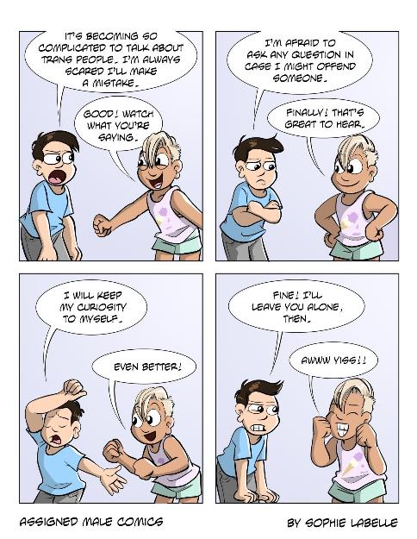
Moving Forward
Things to keep in mind for LGBTQ+ Language.
The person knows best.
Use and respect a person’s pronouns.
“To err is human…”
Check your privilege.
Continue to Learn.
Notes:
Linking to the second half of the presentation; what do we do with this information – how do we move forward.
The person knows best.
Listen to the person you’re interacting with. Hear how they use the language, and replicate their usage.
Understand that language is developing, and just because someone said something was AOK/maybe okay to use, doesn’t mean that local customs and usage will be the case.
Use and respect a person’s pronouns.
He/Him, She/Her, They/Them, Ze/Zim, etc.
If you don’t know what they are, ask.
Asking for information about a person is a sign that you respect them enough that you don’t want to missgender them and continue a cycle of violence.
“To err is human…”
You’re going to make mistakes, its bad, but not the end of the world.
Accept your error, apologize and ask for guidance (if needed), commit to doing better in the future.
Remember: Don’t over apologize.
Check your privilege.
Analyze that the “normalness” of your life, might be as equally normal for others, while being completely different.
Recognize that just because something isn’t a “big deal” to you, doesn’t mean its not a big deal.
Don’t enter the world with the goal of causing pain/suffering.
Continue to Learn.
We’ve spent about 45 minutes today on this topic. We are not expected to be experts, but we are asked to continue to learn and connect with the local community.
Be an ALLY
A – always center the impacted
L – listen & learn from those who live in the oppression
L – leverage your privilege
Y – yield the floor
The status of ally is something that is constantly undertaken, it is not a merit badge that you do once and you are good for the rest of time. The status of ally is given (and removed) by the people who you are an ally to. Any queer person has a right to question whether someone else is an ally to the LGBTQ2S+ community.
Think about practices within your organization that could normalize this process.
When doing introductions, don’t just say their name, say their pronouns.
Change the physical space (gendered/sexualized spaces).
Think about ways to relieve the burden from affected the person/people.
Don’t wait for an affected person to highlight a barrier. Seek them out and remove them.
Don’t require an affected person to educate others. Seek out toolkits and information sessions.
Don’t task an affected person with creating systemic changes. This is everyone’s job to tackle.
Think about ways that problematic behaviors are occurring in the workplace.
Highlight the problems and a more acceptable way forward.
Don’t pass-the-buck to the affected person.
Seek input from those affected.
Seek input from local LGBTQ2S+ organizations/advocates
Consult Style Guides
https://alexkapitan.files.wordpress.com/2017/08/trans-style-guide_rev-july-2018.pdf
https://radicalcopyeditor.com/2018/07/13/update-to-transgender-style-guide-avoiding-invalidating-language-traps/
Additional Links
Are you an ALLY? Being an ALLY to Trans, Intersex & Two Spirit People CC (https://www.youtube.com/watch?v=Amx7dTgmOh4)
5 Tips For Being An Ally (https://www.youtube.com/watch?v=_dg86g-QlM0&feature=youtu.be)
Getting Called Out: How to Apologize (https://www.youtube.com/watch?v=C8xJXKYL8pU&feature=youtu.be)
https://everydayfeminism.com/2013/11/things-allies-need-to-know/
https://www.forbes.com/sites/meimeifox/2019/03/11/why-you-should-consider-transgender-awareness-training-in-your-workplace/#6ddd1cf063a6

Slide 19
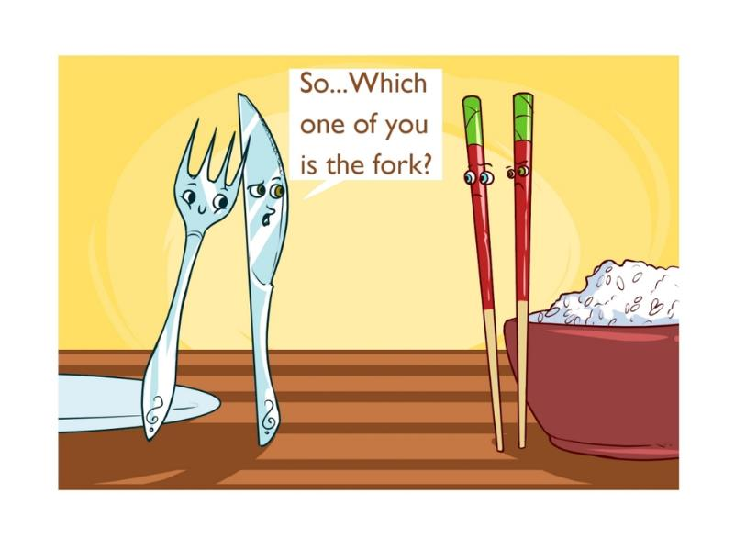
Questions
Ask away. No question off limits.

